Slide 1
Disclaimer
United States Power Squadrons'® publications and seminars ("products") are presented with the understanding that United States Power Squadrons does not render any professional navigation or piloting services or advice related to the actual use of the systems described therein.
Due to the rapidly changing nature of the systems discussed in such Products and potential interference which may degrade the accuracy on such systems, the contents and recommendation contained in such products may become outdated or inappropriate for situations actually encountered on the water existing at the time of the use of any such systems.
As a result, the user of such products must always research original sources of authority and appropriate governmental sources and update the information contained in such products, to ensure accuracy when dealing with a specific situations encountered by the user of such systems.
Notes:
This is a standard disclaimer, to remind you that you, as captain, are responsible for the safety of your boat and crew, not some instrument, book or course

Slide 2
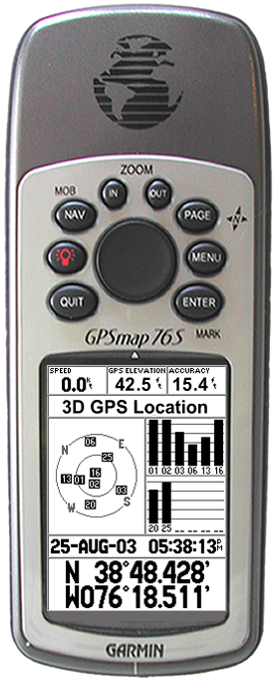
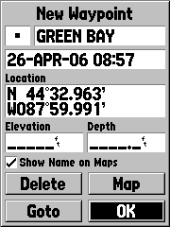
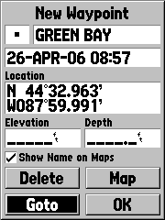
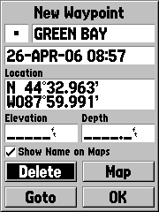
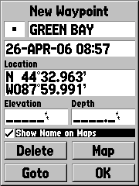
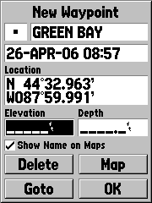
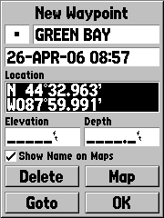
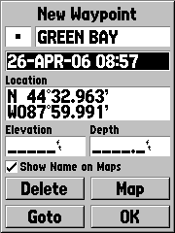
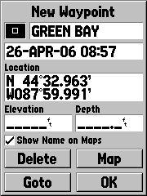
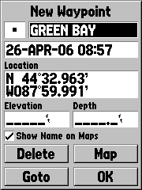
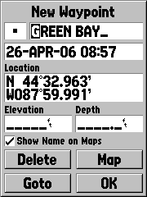
Selecting the
Name Field
“OK” is selected by default, requires Rocking till the Name field is highlighted.
With the NAME field selected press ENTER to confirm.

Slide 3
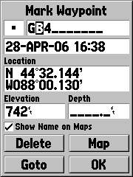

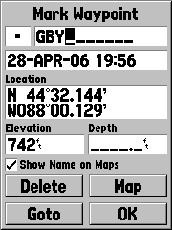


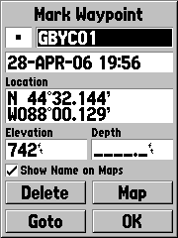

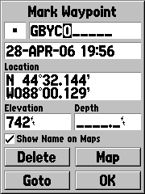

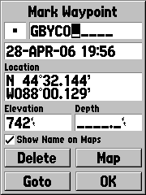

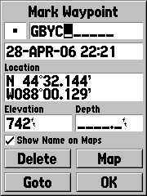
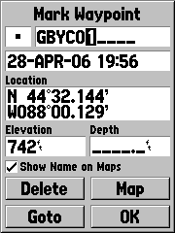
Alpha/numeric Entering
GBYC01
Let’s put the following into the name field: GBYC01
Rocker UP till “G” shows.
Rock RIGHT to second character
Rocker UP till “B” shows.
Rock RIGHT to third character.
Rocker DOWN till “Y” shows.
Rock RIGHT to fourth character.
Rocker UP till “C” shows.
Rock RIGHT to fifth character.
Rocker DOWN till “0” shows.
Rock RIGHT to sixth character.
Rocker DOWN till “1” shows.
Press ENTER to Confirm.

Slide 4
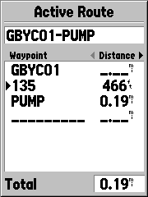
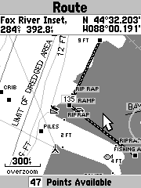
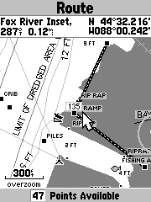

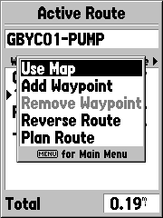
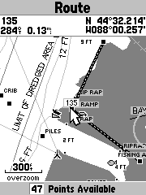
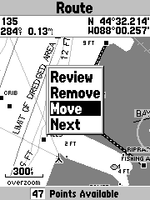

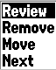
Move a Waypoint (1)
Page to Active Route Page
press Menu
Select Use Map
press ENTER
Rock Pointer to the Waypoint
Notes:
This is the 1st method

Slide 5

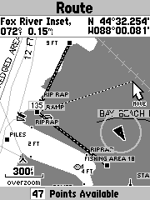
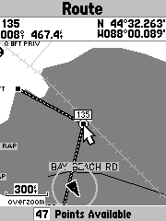
Move a Waypoint (2)
Rock down to select Move.
press ENTER
Rock the Map Pointer to the new location
See trail between waypoint and Map Pointer
When you arrive,
press ENTER
And that is how the waypoint is moved on the Chart.
Notes:
This is the 1st method

